Slide 1
Connectivity and Flows

Slide 2
Connectivity In UNDIRECTED Graphs
An undirected graph is connected if there is a path between every pair of vertices
A graph is k-vertex connected or k-connected if
It has more than k vertices
Will remain connected if less than k vertices are removed
What is the connectivity of a tree ?
What is the connectivity of a clique ?
What is the connectivity of a cycle

Slide 3
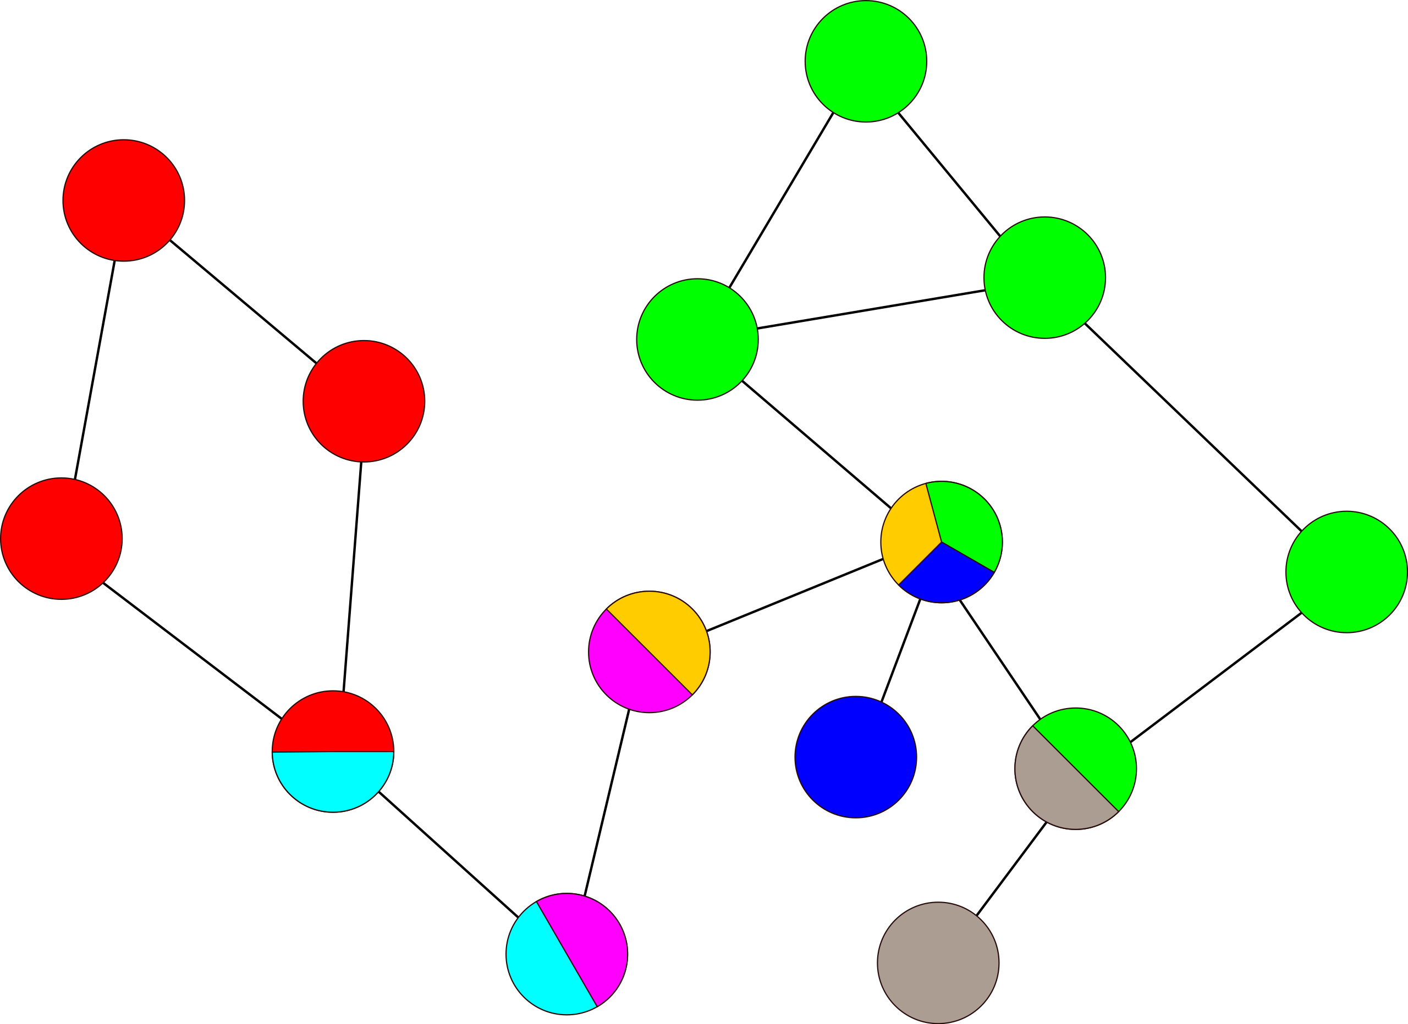
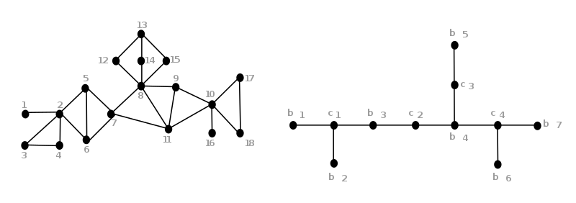
BI-Connectivity
A graph is bi-connected if removal of any one vertex does not disconnect it.
If the removal of a vertex disconnects a graph, that vertex is known as the cut-vertex or articulation point
Any connected graph can be decomposed into a tree of its bi-connected components. This is called the block-cut tree of the graph
Each color represents a component. Articulation points have colors from both the components
By Zyqqh at English Wikipedia, CC BY 3.0, https://commons.wikimedia.org/w/index.php?curid=19053091
B1[1,2]; B2[2,3,4]; B3[2,5,6,7]; B4[7,8,9,10,11];
B5[8,12,13,14,15]; B6[10,16]; B7[10,17,18]
c1=2; c2=7; c3=8;c4=10

Slide 4
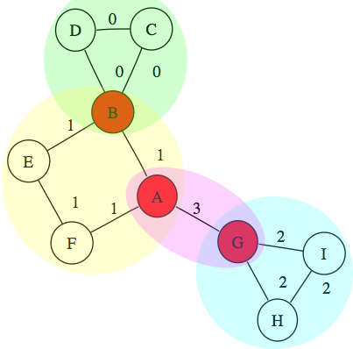
TARJAN’S ALGORITHM FOR FINDING BI-CONNECTED COMPONENTS (1972)
https://www.boost.org/doc/libs/1_34_0/libs/graph/doc/biconnected_components.html
Do a depth First Traversal of the Graph
Create a tree with directed edges showing order of traversal
Set Num(v)=the order in which graphs are visted
Add remaining edges to the tree as back edges
Set Low(v) as the lowest vertex that can be reached using tree edges and at most one back edge
If for any vertex (other than root) v with child w Low(w) >= Num(v) , then v is an articulation point
If root has more than one child root is an articulation point

Slide 5
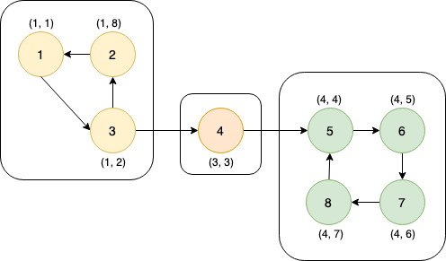
TARJAN’s ALGorithm for finding Strongly connected Components (1972)
A directed graph is strongly connected if there is a path between any two vertices while maintaining the direction of the edges.
Tarjan’s algorithm can be modified to find strongly connected components

Slide 6
DiSJOINt PATHS
Given two vertices v and w;
Edge-disjoint paths are the maximum number of paths from v to w that have no edge in common
Vertex-disjoint paths are the maximum number of paths from v to w that have no vertices in common
A vw-disconnecting set is a set of edges such that each path from v to w includes at least one edge from the set
A vw-separating set is a set of vertices such that each path from v to w includes at least one vertex from the set
Introduction to Graph Theory. Wilson
Edge disjoint paths (v,w)
(v,p,s,u,w) ; (v,q,s,x,w)/(v,q,t,y,w); (v,r,t,z,w)
Vertex disjoint paths (v,w)
(v,q,s,x,w), (v,r,t,z,w)
Disconnecting set
{ps, qs, ty, tz} {uw,xw,yw,zw}
Separating set
{s,t}; {p,q,y,z}

Slide 7
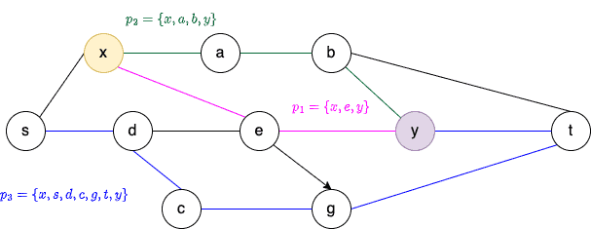
MENGER’S THEOREM(s) (1972)
The maximum number of edge disjoint paths connecting two distinct vertices v and w in a connected graph is equal to the minimum number edge in a vw-disconnecting set
Minimum disconnecting set=> edge connectivity
If minimum size k, then graph is k-edge-connected
The maximum number of vertex disjoint paths connecting two distinct vertices v and w in a connected graph is equal to the minimum number vertices in a vw-separating set
Minimum separating set => vertex connectivity
If minimum size k, then graph is k-vertex-connected

Slide 8
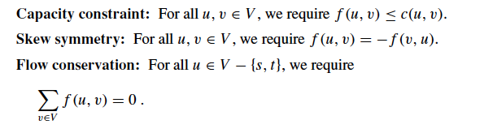
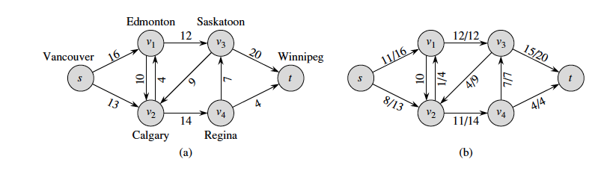
Flow Networks
A flow network is a directed graph where each edge has a non negative capacity
Follows the three properties;
What is the maximum flow through a network ?

Slide 9
Basic Algorithmic Step
Find a Path from Source to Sink
Depth First from Source until we hit Sink
Update the flow along the path
Remove the edges with 0 flow
Continue until there are no paths from Source to Sink

Slide 10
Example
S
S
S
S
3
2
3
2/2
2/3
1
1
1
1
A
B
A
B
A
B
A
B
4
2
4
2/2
4
4
3
3
2/3
C
D
C
D
C
D
C
D
2
3
2
2/3
2/2
1
1
T
T
T
T

Slide 11
Problem
S
3
2
1
A
B
Not guaranteed to find maximum flow if we start from the wrong edge
Need provision to retrace our steps
4
2
3
C
D
2
3
T

Slide 12
Ford-Fulkerson Algorithm
Find a Path from Source to Sink
Depth First from Source until we hit Sink
Update the flow along the path
Remove edges with 0 flow
Add edges in opposite direction for reverse flow
Continue until there are no paths from Source to Sink

Slide 13
ISSUES
S
Guaranteed to converge only if the weights are rational numbers.
100
100
A
B
1
100
100
T
If we always choose the edge (a,b) or (b,a) we will need 100 steps to terminate

Slide 14
Modification
Always choose the augmenting path that allows largest increase to flow.
Like weighted shortest-paths (other way round)
Modification of Dijkstra’s algorithm (Breadth First)
Edmond’s-Karp Algorithm

Slide 15
MAX FLOW MIN Cut THEOREM
The maximum value of an s-t flow is equal to the minimum capacity over all s-t cuts.
The maximum amount of flow passing from the source to the sink is equal to the smallest total weight of the edges which if removed would disconnect the source from the sink.

Slide 16
Communities in Networks
Identifying communities is a very important feature of networks
Communities are groups of vertices that are tightly connected to each other
Example: groups of friends in social networks, groups of similarly acting genes in biological networks, groups of customers who buy similar items in reccomendation networks
Mathematically, communities are a mapping of vertices to groups

Slide 17
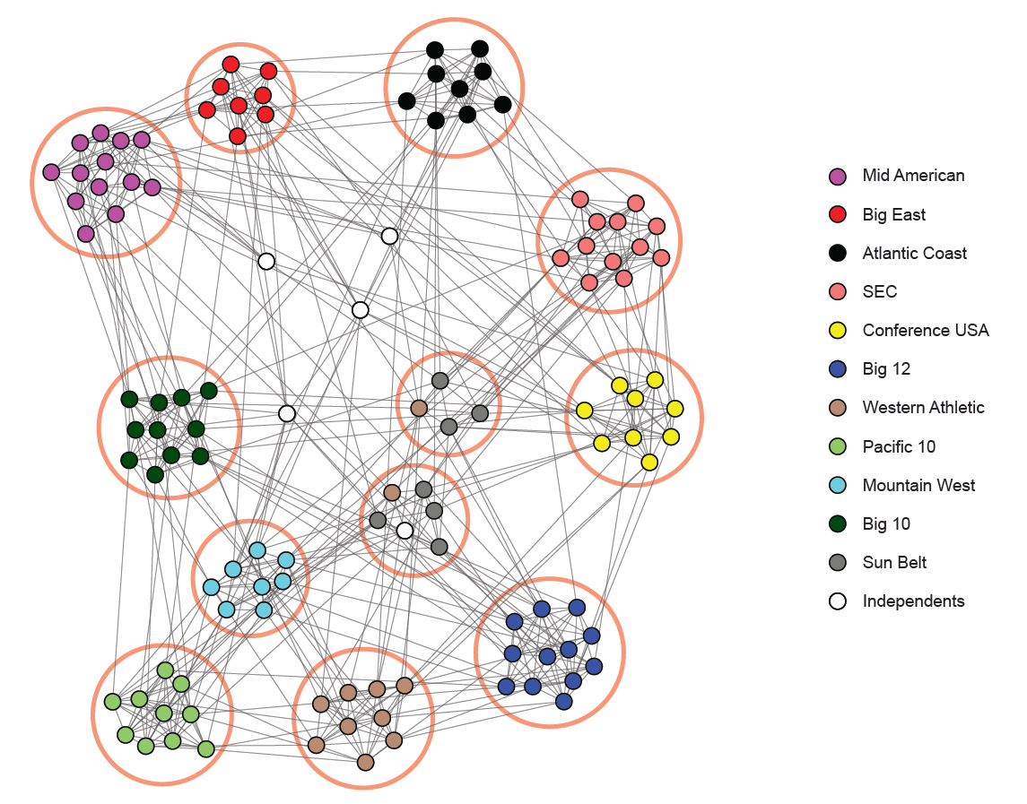
Example of Communities based on NCAA matches http://snap.stanford.edu/agm/

Slide 18
Community Detection
Note that there is no exact mathematical description of communities
In real-world systems communities are generally user defined
Algorithms for detecting communities generally optimize a parameter to obtain tightly connected communities
Communities obtained by different algorithms can produce different mappings

Slide 19
Ground Truth
Ground Truth represents the correct mapping of vertices to communities
Ground truth is defined by the user or the application. It is not defined mathematically.
The effectiveness of a community detection algorithm is determined by how close it is to the ground truth.

Slide 20
Partitioning vs Community
Partitioning is used for resource management. There is no “correct” answer
Community detection is used to find something about the system. Generally there is a “correct” answer or ground truth.
The number of partitions are known beforehand
The number of communities is not known before hand
It is desirable that each partition be of the same size
The size of communities can vary
All graphs can be partitioned
Not all graph have communities

Slide 21
Modularity
The main philosophy is that the vertices in a community should be more connected, than the number of connections obtained by random choice
We assign vertices to communities such that the total modularity is maximized

Slide 22
Formula for Modularity
Let the number of edges be m
Thus total degree is 2m
Let vertex i have degree ki, and vertex j have degree kj
Thus the probability that an edge attaches to vertex i (j) is ki/2m (kj/2m)
Thus the expected connections between vertices i & j is (ki*kj)/(2m)²
Thus the expected edges between all pairs of vertices isΣ_{ij}[(ki*kj) (2m)²]

Slide 23
Formula for Modularity
Let ci be the community of vertex i and cj be the community of vertex j
The Kronecker delta function δ(ci,cj) is defined as
δ(ci,cj) =1 if ci=cj (i and j in the same community
δ(ci,cj) =0 if ci≠cj (i and j in the different communities
Thus the number of expected edges within communities is Σ_{ij}[(ki*kj)/(2m)²] *δ(ci,cj)

Slide 24
Formula for Modularity
Let A be the adjacency matrix of the graph
Total number of edges between i and j is A_{ij}
The total number of edges between all pairs of vertices, given that the vertices are in the same community is Σ_{ij} A_{ij}*δ(ci,cj)
The fraction of the edges isΣ_{ij} A_{ij}/2m*δ(ci,cj)

Slide 25
Formula for Modularity
Modularity (Q) measures by how much the fraction of the total edges within community is greater than the expected number of edges
Q=Σ_{ij} A_{ij}/2m*δ(ci,cj) -1/2Σ_{ij}[(ki*kj) (2m)²]
Q=1/(2m)Σ_{i j}[A_{ij}-(ki*kj)]*δ(ci,cj)
The goal of modularity maximization is to divide the network into communities such that Q is maximized.
Maximizing modularity is NP-complete

Slide 26
Maximizing Modularity (CNM)
Start with every node in its community
For every pair of communities, compute how the value of Q would change as the communities are merged.
Merge the communities with the highest Q
Continue until value of Q no longer increases
Find algorithm in:
Finding community structure in very large networks. By Clauset, Newman and Moore

Slide 27
Maximizing Modularity
Although when it was published, CNM was one of the faster algorithms, it is still slower and may not achieve the maximum modularity
All the pairs of communities are checked. It is more practical to check only the communities that have edges between them since communities that are not connected will not be merged
Once two communities are merged, they are not unmerged again. Thus a wrong decision can reduce the modularity

Slide 28
Maximizing Modularity
The Louvain method addresses these rules to obtain higher and faster modularity
https://perso.uclouvain.be/vincent.blondel/research/louvain.html
Checks Q only between neighboring communities
Conducts several iterations by moving vertices from one community to another to improve Q

Slide 29
Issues with Maximizing Modularity
Although maximizing modularity is very popular, obtaining the maximum modularity may not guarantee the correct or best communities
Performance of modularity maximization in practical contexts. Good, de Montjoye, Clauset

Slide 30
Issues with Current Methods
Resolution Limit
Communities below a certain size get merged into larger communities
Multiplicity of Solutions
Same optimum value can give different community distributions
Value of metric does not relate to quality of result
Value depends on size of network rather than the community structure
Cannot identify bias in ground truth
Finds communities even when there is no community structure

Slide 31
Resolution Limit
By maximizing modularity, some smaller communities can get absorbed into larger ones.
Nice example given in Resolution Limit in Community Detection by Fortunato and Berthelemy

Slide 32
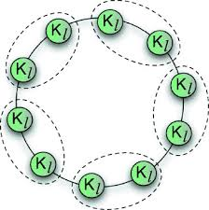
Resolution Limit
Consider a network of cliques each of size m. The cliques are connected in a cycle, where clique(i) is connected by an edge to clique(i+1) and by an edge to clique (i-1)
The modularity is maximized when two cliques join in a community
In reality each clique should be its own community

Slide 33
Multiplicity of Solutions
When maximizing Q at each step, we might run into ties. Due to tie breakers, several possible valid communities are possible for the same value of modularity
Constant Communities in Complex Networks by Chakraborty, Srinivasan, Ganguly, Bhowmick, and Mukherjee,

Slide 34
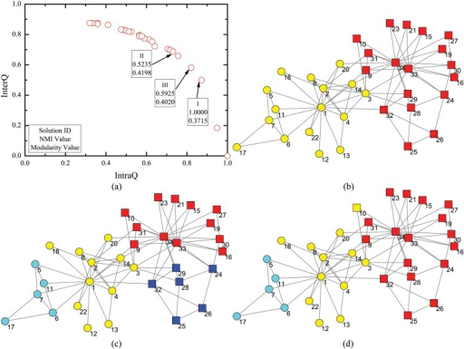
Multiplicity of Solutions
Three different community allocation of the same network.
Modularity values are close,
.41, .40, .37
Modularity of .37 is the best match with the ground truth

Slide 35
Not Universal Reference
Modularity is not an universal reference across all communities.
We only compare high modularity with respect to all other modularity values obtained from the same network
Modularity depends on the size of the network.
Consider a two cliques of size 10, connected by an edge and a grid of 2K by 2K vertices. The grid will have higher modularity, even though it does not have any community structure

Slide 36
Validation of Results
The correctness of community detection algorithms is measured by comparing the communities obtained from the algorithm with the actual communities (ground truth)
One of the most used measure is Normalized Mutual Information

Slide 37
Normalized Mutual Information
Consider a set of elements that can be grouped in two ways (i)by color (green, red, blue) and (ii) by shape
x1
x2
x3
y1
y2
y3

Slide 38
Normalized Mutual Information
Given two criteria of groupings X and Y, NMI computes how close are these groupings
X contains clusters x1, x2, …xm
Y contains clusters y1, y2,…ym
nij=|xi∧yj| (number of common elements in groups xi and yi)
ni=|xi|and nj=|yj| (total number of elements in the groups
Total number of elements is n

Slide 39
Normalized Mutual Information
pij= nij/n (the probability that an element will belong to both xi and yj)
pi=Σpij (over all j) (the probability that an element will belong to xi
pj=Σpij (over all i) (the probability that an element will belong to yj
The mutual information is given by

Slide 40
Normalized Mutual Information
This mutual information is normalized by the average of the entropies
H(X)=-Σpi*log(pi)
The normalized mutual information is given by
NMI(X,Y)= -2*I(X,Y)/ (H(x)+H(Y))
Note that the value is 1 when the grouping match exactly and is 0 when the grouping do not match

Slide 41
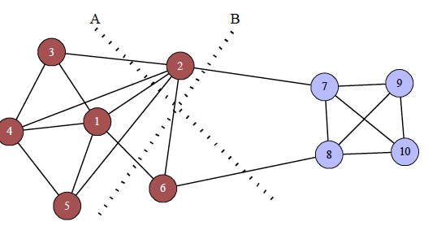
NMI on Graphs
NMI is defined for clusters, but it does not take into account the the edges connecting the vertices
Consider the red and blue groups to be the ground truth
Two algorithms A and B findtwo different sets of communities

Slide 42
NMI on Graphs
Out of A and B, which algorithm is closer to the ground truth ?
A mislabels 2
B mislabels 6
It can be argued that A’s mistake is larger since 2 has more connection to the red community than 6

Slide 43
NMI on Graphs
However, the NMI of A and B with comparison to the ground truth is equal
The paper “Generalized Measures for the Evaluation of Community Detection Methods” , suggest modifying the NMI computation by weighting the vertices with their number of edges

Slide 44
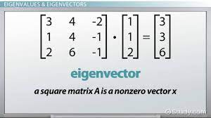
Eigen Vectors and Eigen Values
Multiplying a nxn matrix A and a n-dimensional vector x, gives a n-dimensional vector y
We can say that the vector y is transformed by A (Ax=y)
Sometimes y is just a scalar multiple of x
Ax=y=λx
Then λ is a eigen value of A and x is the corresponding eigen vector

Slide 45
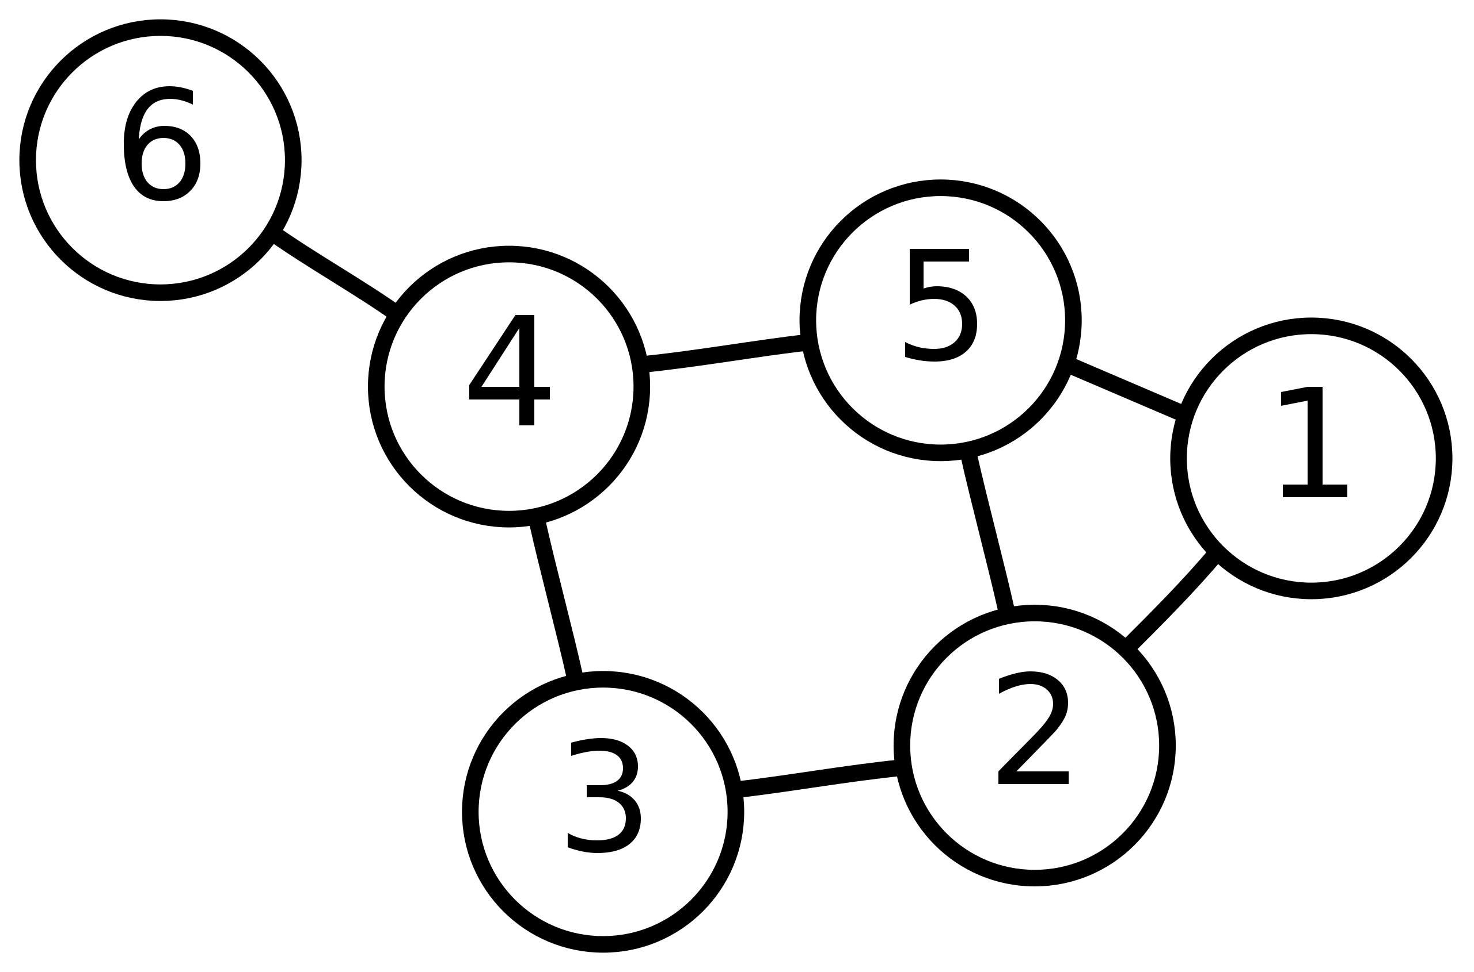
ALGebraic Connectivity
The algebraic connectivity of a graph is the Fiedler value (second smallest eigen value) of the Laplacian matrix of the graph
Laplacian matrix= Diagonal-Adjacency matrix
Fiedler vector is the eigen vector associated with the Fiedler value
To partition a graph, take the vertices corresponding to the negative values in one partition and the vertices corresponding to the positive values in one partition
Fiedler vector= {.415,.309,.069, -.221,.221, -.794 }
Fiedler value=.722

Slide 46
Graph Partitioning
The goal of graph partitioning is to divide the graph into equal size subgraphs, while minimizing the number of edges between the subgraphs
Cut size=number of edges across partitions
Used for dividing work across parallel processors
The correctness of graph partitioning is defined by how well it optimizes the two parameters
There is no ground truth to graph partitioning. Multiple answers are possible depending of the graph

Slide 47
Graph Partitioning
Some algorithms for graph partitioning include:
Kernighan Lin
Spectral Partitioning
METIS is one of the most popular software for graph partitioning
http://glaros.dtc.umn.edu/gkhome/metis/metis/overview

Slide 48
Kernighan Lin Algorithm
First Divide the set of vertices to two groups A and B
Objective: to minimize cut size
Until the cut size can no longer be improved
For all pairs of vertices; where i in A and j in B
Find the pair that minimizes the cut-size or failing that, least increases the cut-size
Swap the partitions, by placing i in A and j in B. Mark this as a state of the graph
Continue to finds pairs to swap, except the vertices that have already been moved
Iteration ends when no more vertex pairs are left to be swapped
Of all the the states formed during the iteration, find the one with the smallest edge cut. Use this division for the next iteration

Slide 49
Features of K-L
With enough iterations we will obtain the state with the minimum cut-size.
Easy to implement.
Extremely expensive. Total time for one iteration (the blue colored) lines in O(mn), where m is the number of edges and n is the number of vertices.
However, if you have a nearly partitioned graph, you can use K-L to refine the last few steps.

Slide 50
Spectral Partitioning
Spectral partitioning provides a faster method for partitioning the graph based on the eigen decomposition of the Laplacian matrix of the graph.
Consider the adjacency matrix of the graph, A,
A_{ij} is 1 if i and j are connected. Our goal is to minimize the sum of Aij, where i and j are in different groups.

Slide 51
Spectral Partitioning
Goal is to minimize R=1/2ΣA_{ij} i and j in different groups. The ½ factor is so that we consider each edge only once.
Let si=+1 if vertex i in group 1 and si=-1 if vertex i in group 2. The vector s stores the values of si
The ½(1-sisj)=0 if i and j are in same group and ½(1-sisj)=1 if i and j are in different group
Thus we can write the minimization functions as
R=1/4ΣA_{ij}(1-sisj)

Slide 52
Spectral Partitioning
R=1/4ΣA_{ij}(1-sisj) over all i and j, can be written as
R=1/4(ΣA_{ij}-ΣA_{ij}sisj)
Note that ΣA_{ij} for each row is just the degree of the vertex
Let the degree of vertex i be ki
Then ΣA_{ij}=Σk_{i} summed over all i
Consider the Kronecker delta function δ_{ij}
δ_{ij}=1 if i and j are in the same group and 0 otherwise
We can thus write Σa_{ij} in terms of si and sj as follows;
ΣA_{ij}=Σk_{i} =Σk_{i}δ_{ij}sisj summed over all i and j

Slide 53
Spectral Partitioning
Thus we can write the optimization function R as;
R=1/4(ΣA_{ij}-ΣA_{ij}sisj)
R=1/4(Σk_{i}δ_{ij}sisj-ΣA_{ij}sisj)
The Laplacian Matrix of A is given by L=D-A, where D is a diagonal matrix, Dii= ki
We can write the each element of the Laplacian matix L_{ij=}k_{i}δ_{ij}-A_{ij}
We can thus replace A by L, R=1/4ΣLijsisj

Slide 54
Spectral Partitioning
In the previous slide we saw that the optimization function can be written as a summation of the Laplacain matrix and the vector s.
We can therefore write R as a matrix vector multiplication form
R=1/4 s^{T}Ls s^{T} is the transpose of s
L represents the structure of the network
s represents the division of the vertices into two groups.
The structure of L remains constant, we have to find the values of s that can minimize this function

Slide 55
Spectral Partitioning
There are two constrains to the values of s
Note that as per our earlier defintion, si can be only +1 or -1. However, this is a very strong restriction. Instead we loosen the constrain by requiring
Σsi²=n, where n is the number of vertices.
Σsi=n1-n2, where n1 is the number of vertices in group 1 and n2 is the number of vertices in group 2
Note that both these constraints holds if si=±1, but for other values of s as well

Slide 56
Spectral Partitioning
We write the minimization function along with the two constraints, so that the constraints are enforced
We remove the ¼ constant since that does not affect the minimization process
The function then becomes
ΣLijsisj+λ(n-Σsi²)+2μ((n1-n2)-Σsi)
Blue: Optimization function
Orange: First constraint
Green: Second constraint
λ and 2μare Lagrangian multipliers

Slide 57
Spectral Partitioning
We will now take the derivative of this expanded function, and find out for which value of s the derivative is 0
Derivative with respect to si
For terms L_{ab}sasb, a,b≠i, the derivative is 0
For terms L_{ai}sasi, the derivative is L_{ai}sa
L_{ai}sa occurs twice once for L_{ai}sisa and once for L_{ai}sasi
For terms L_{ii}sisi, the derivative is 2L_{ii}si
For terms n-sa²; a≠i, the derivative is 0
For terms n-si²; the derivative is -2si
For terms (n1-n2)-sa; a≠i, the derivative is 0
For terms (n1-n2)-si; the derivative is -1

Slide 58
Spectral Partitioning
Taking all the values together, we get the derivative with respect to si as
2Σ_{summed over j}L_{ij}sisj+λ(-2si)+2μ(-1)
For the minimum value of the expanded function, this value should be zero
2Σ_{summed over j}L_{ij}sisj+λ(-2si)+2μ(-1)=0
Cancelling the 2s we get
Σ_{summed over j}L_{ij}sisj=λsi+μ
Since we are considering the derivative for every si, we can write this in the matrix form as;
Ls=λs+μ1, L is a matrix, s is a vector and 1 is a vector of 1s

Slide 59
Spectral Partitioning
We use the following properties
L.1 =0, multiplying the Lapalacian with a vector of 1s gives 0
1^{T}1=n, if length of the 1 vector is n
Since Σsi=n1-n2, we can write it in vector notation as 1^{T}s=n1-n2
Multiplying the function Ls=λs+μ1 on the let by 1^{T} and using these properties we get,
μ=-(n1-n2)/n*λ

Slide 60
Spectral Partitioning
Let vector x=s+μ/λ*1
Lx=L(s+μ/λ*1)=Ls=λs+μ1 =λx (using L.1=0)
Thus x is an eigenvector L with the eigen value λ
There can be several values of x and λ pairs. We should choosethe one that minimizes the cut size

Slide 61
Spectral Partitioning
Recall the optimization function
R=1/4 s^{T}Ls
This can be written as R=1/4 x^{T}Lx,
Because x=s+μ/λ*1 and L*1=0
Thus R=1/4 λ x^{T}x
x^{T}x=4n1n2/n
R=n1n2/n*λ
Thus R is proportional to λ
So we should pick the smallest eigen value

Slide 62
Spectral Partitioning
To minimize the cut size we should select the smallest eigen value
The smallest eigen value is 0, this corresponds to the eigen vector of 1.
This means that all the vertices are in the same partition, thus the cut-size is zero
We therefore pick the second smallest eigen vector

Slide 63
Spectral Partitioning
Thus spectral partitioning can be done as follows;
Find the second smallest eigen value and the corresponding eigen vector of L
If si>0, place vertex in group 1
If si<0, place vertex in group 2

